Slide 1
RESPONSIVE WEB PAGE DESIGN (4330705)

Slide 2
Micro Project : Hotel management system
Submited by –
Vadhiya arti – 236270307113
Seeda puri – 236270307096
Solanki Bhumika - 236270307100

Slide 3
Objectives -To create a user-friendly interface for hotel management. - To allow users to book rooms, check availability, and manage their bookings. - To provide an administrative interface for hotel staff to manage bookings and customer information.

Slide 4
Key Features
1. Room Booking: Users can search for available rooms and make reservations.
2. Check-in/Check-out: Manage the check-in and check-out process for guests.
3. Billing System: Generate bills for guests based on their stay.
4. User Management: Admin can manage user accounts and bookings.

Slide 5
MODULE DESCRIPTION Home: This is the first page of the yog trainer website where you have an access to every part of the yog. About: this module provides some basic information about yoga trainer details and philosophy about yoga. Services: In this page, all the information about the services is given. Gallery: This page has all the information to our present in hotel.

Slide 6
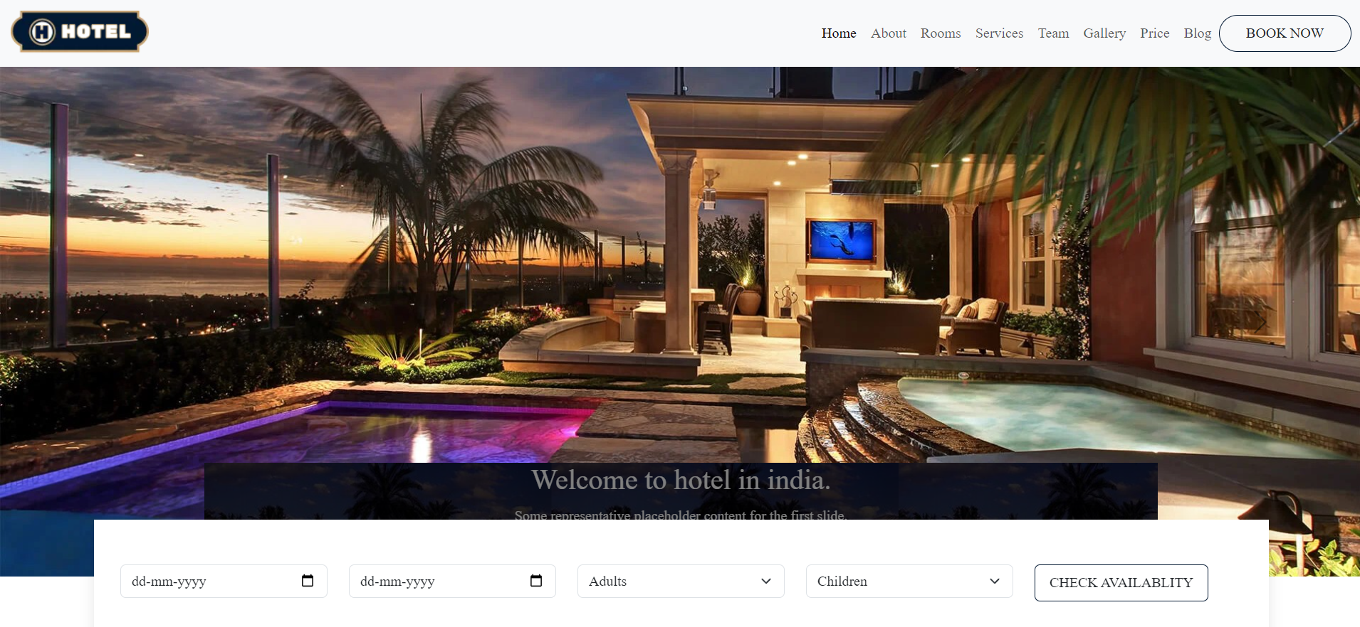

Slide 7
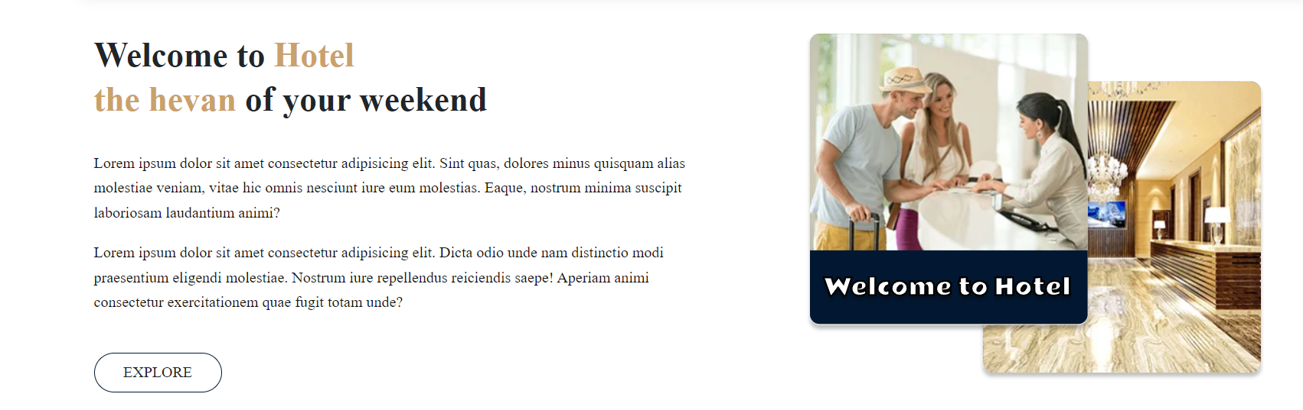

Slide 8
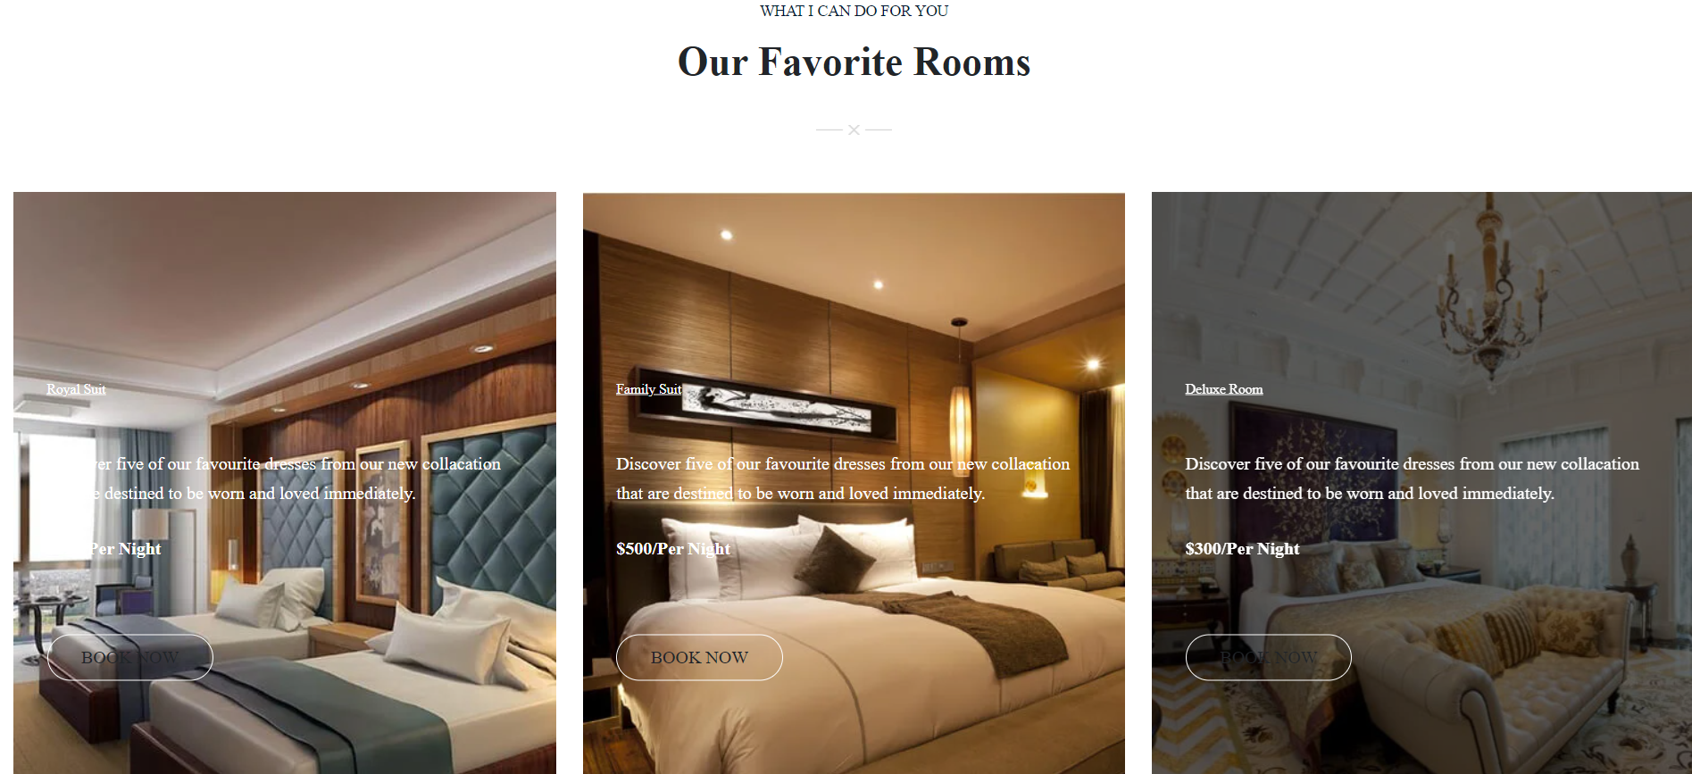

Slide 9
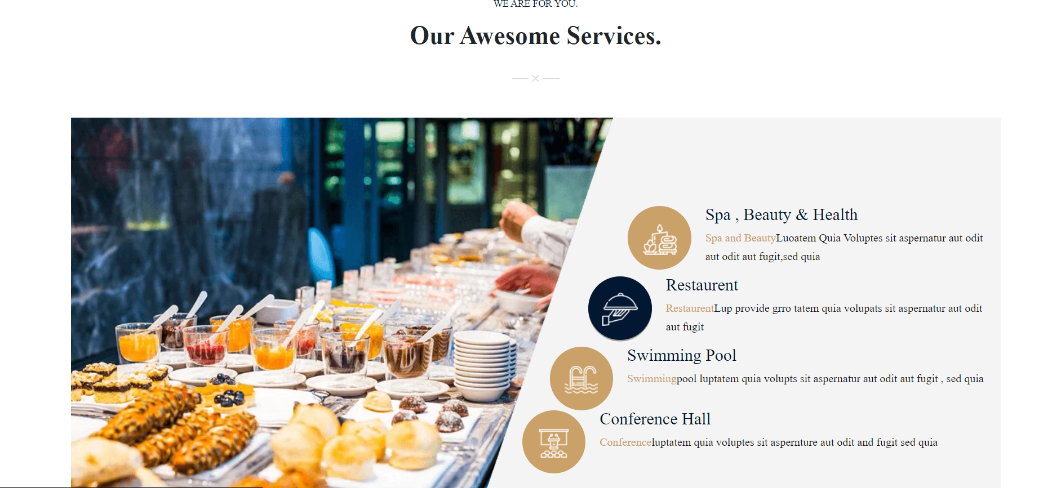

Slide 10


Slide 11
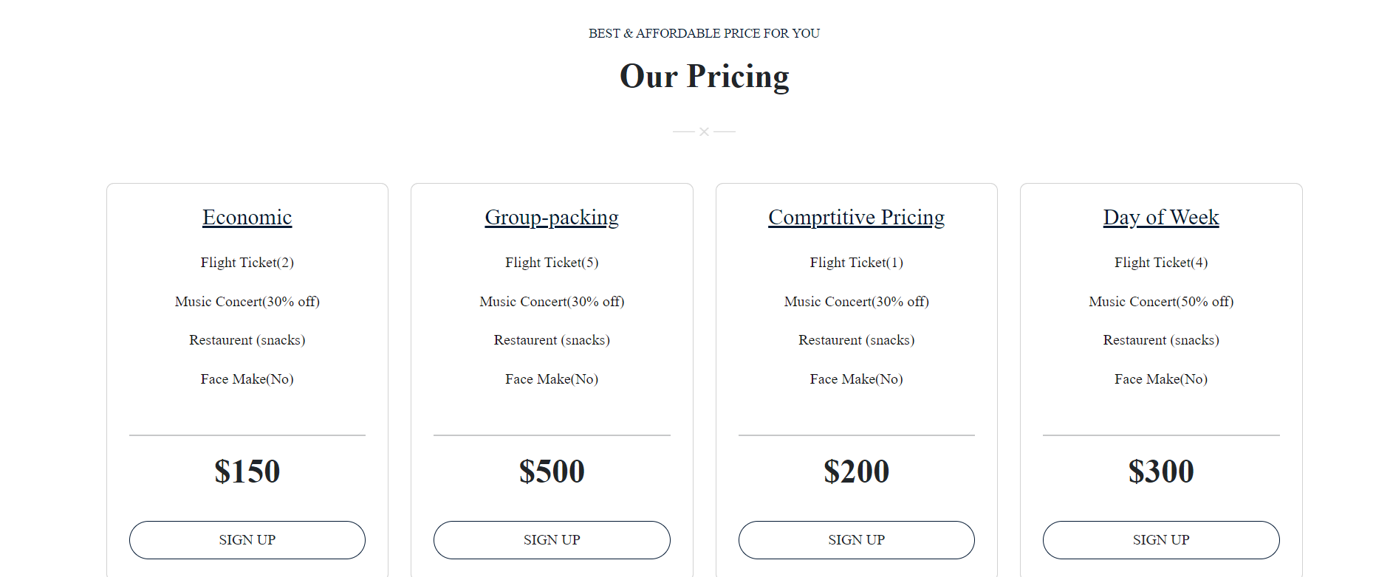

Slide 12
Thank you

